Slide 1
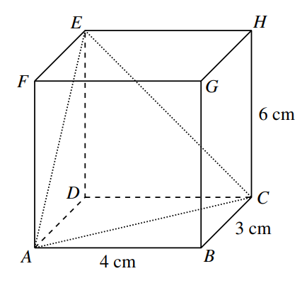
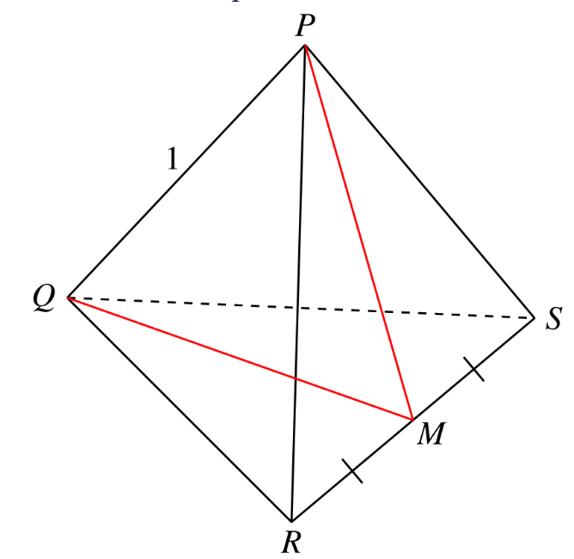
(0,3,6)
(0.5,sqrt(3)/6,sqrt(2/3))
(0,3,0)
(4,3,0)
(0.5,sin60,0)
(.5,sin60,0)
(1,0,0)
(0,0,0)
(1,0,0)

Slide 2
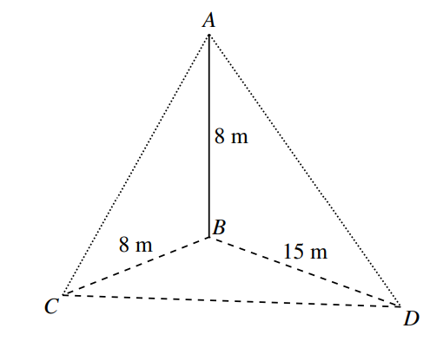
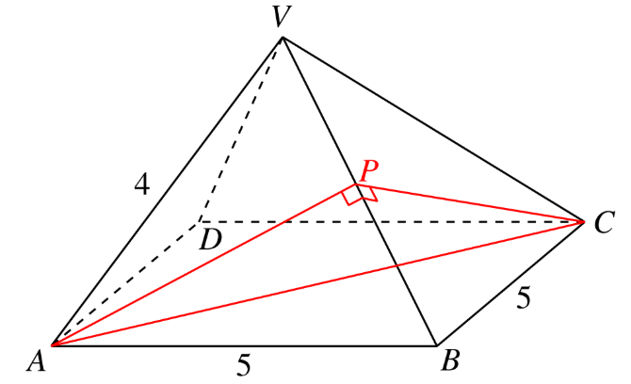
(2.5,2.5,sqrt(3.5))
(0,8,8)
(5,5,0)
(0,8,0)
(5,0,0)
(15,8,0)

Slide 3
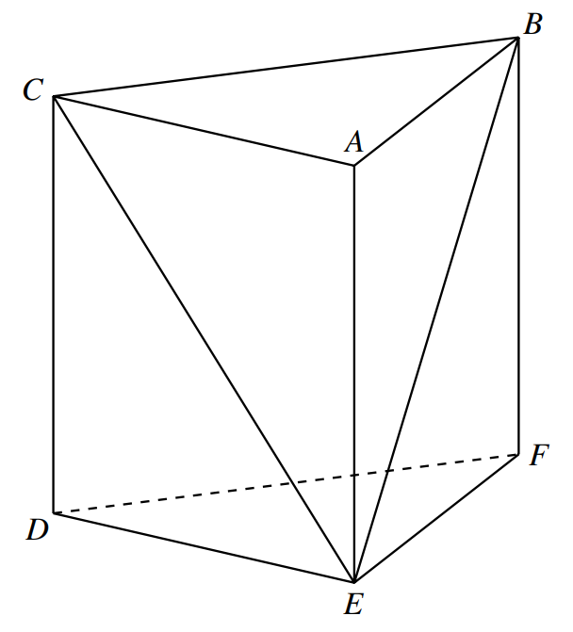
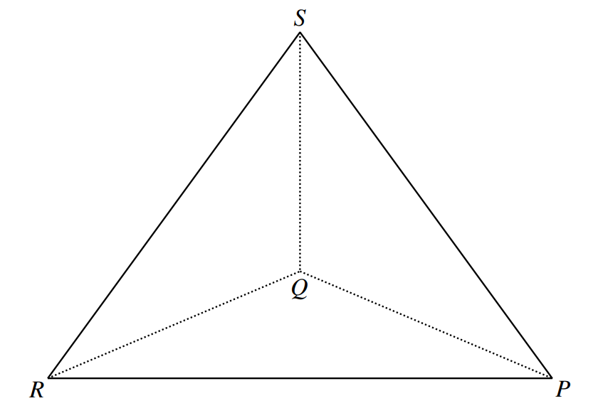
(0,1,0)
(-1,0,0)
1
90° − θ
1
θ
θ
(0,0,0)
90° + θ
2
(0,0,1)
(0,0,-2)
(0,0,0)
(sqrt(3),0,0)
(0,-1,0)

Slide 4
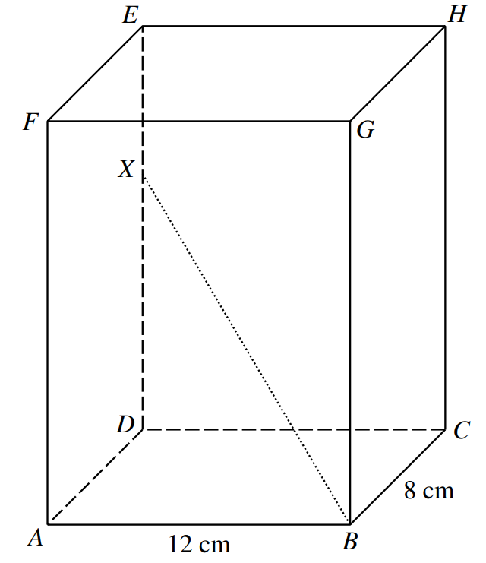

S(0, 0, 1)
(0,0,13)
(0,8,9)
Q(0, 0, 0)
R(0, −1, 0)
F(0, 1, 1)
E(0, 0, 1)
A(1, 1, 1)
(12,0,0)
D(1, 0, 1)
(0,0,0)
G(0, 1, 0)
H(0, 0, 0)
B(1, 1, 0)
C(1, 0, 0)

Slide 5
P(0, 0, 1)
E
H
F(0, 0, 24)
G
15 cm
Q(0, 0, 0)
Q(16, 12, 9)
9 cm
S(0, tan 53°, 0)
D(0, 12, 0)
C(16, 12, 0)
R(0, −tan 47°, 0)
P(8, 6, 0)
12 cm
A(0, 0, 0)
16 cm
B(16, 0, 0)

